Slide 1
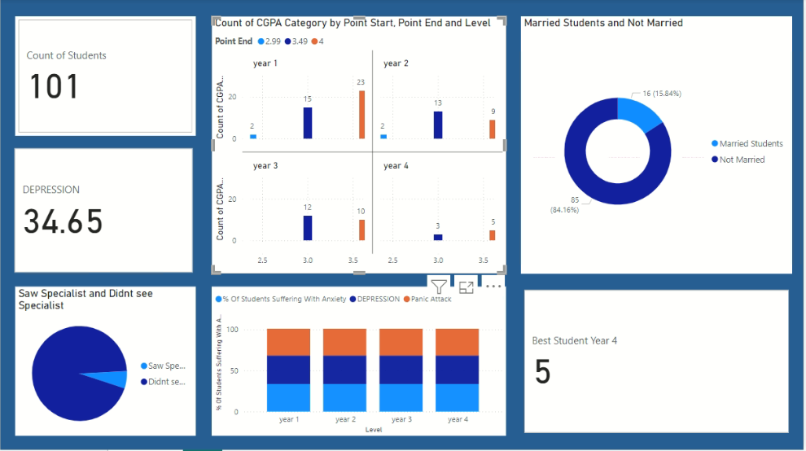
STUDENT MENTAL HEALTH DASHBOARD

